Slide 1
VLAN Operation and Configuration
Will practice the following concepts
Vlan Basics
Vlan Truniking
Inter—VLAN routing
layer 3 Switching

Slide 2
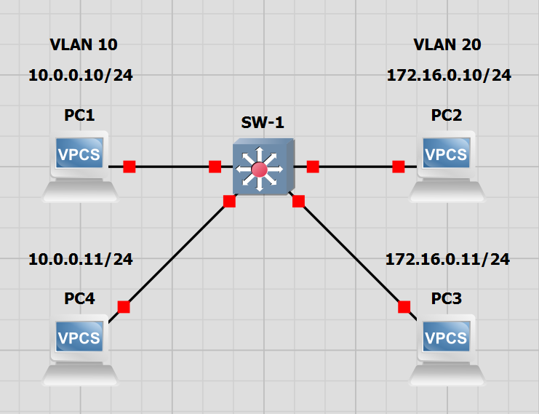
NETWORK TOPOLOGY
We will configure the switch to recognize each pc and will configure the ports to the according VLANs

Slide 3
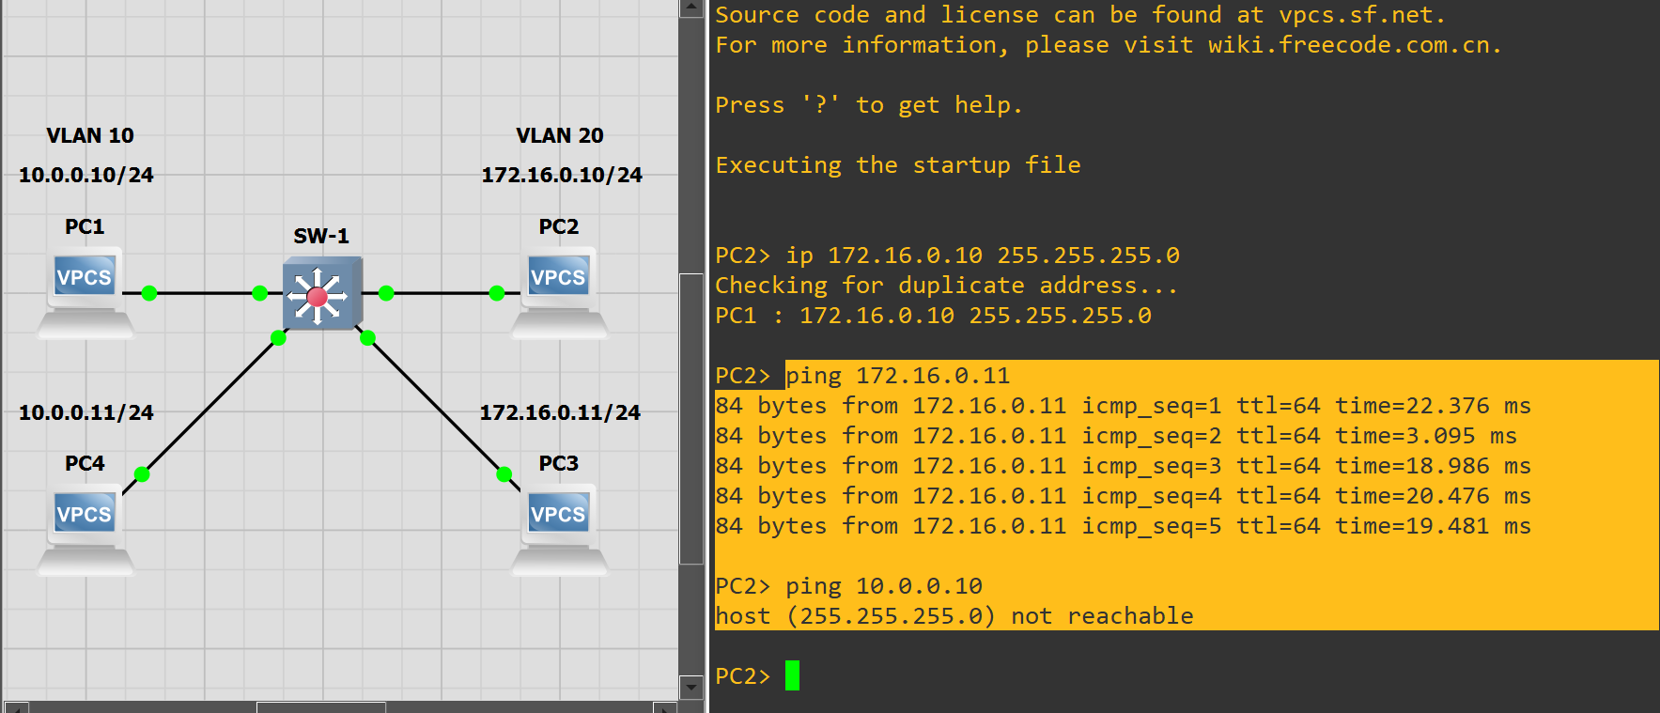
After configuring the switch with basic setting and each PC with appropriate IP addresses, we can test if the switch will forward traffic to separate sub nets. It does not.

Slide 4
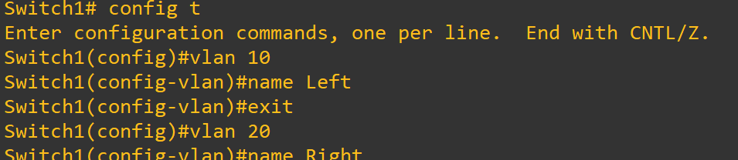
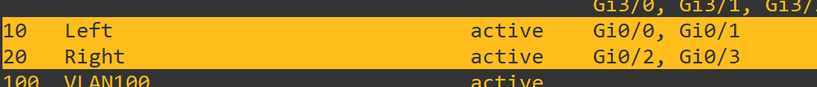
Vlan 10 config on switch
Enabling and naming separate VLANs
Int g0/1
Switchport mode access
Switchport access vlan 10 (or any from 2-1000)
Int g0/0
Switch port mode access
Switchport access vlan 10
Each VLAN configured to contain only the appropriate ports
Vlan 20 config on switch
Int g0/2
Switchport mode access
Switchport access vlan 20 (or any from 2-1000)
Int g0/3
Switch port mode access
Switchport access vlan 20

Slide 5
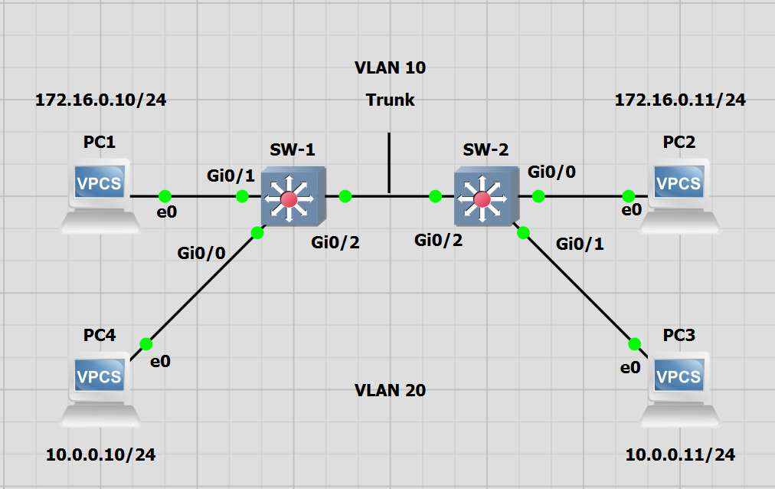
Configuring Trunking Between Switches

Slide 6
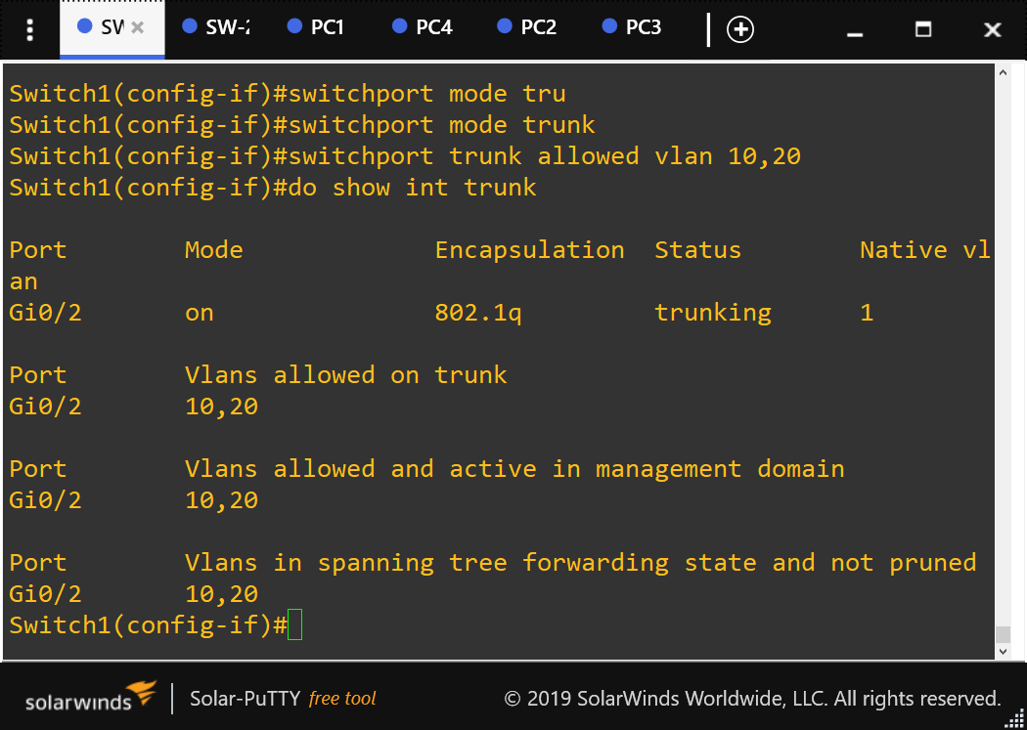
Will add in another switch with a similar configuration to Switch1. However, will need to change interface g0/0 to access VLAN 10 and interface g0/1 to access VLAN 20 on each switch. PCs Ips will need to be changed as well to create a matching pair of IPs on each VLAN before adding the TRUNK port.
Configuring Truncking Between Switches
Config t
Int g0/2
Switchport trunk encapsulation dot1q ( to set the encapsulation to use 802.1Q encapsulation instead of auto
Switchport mode trunk
Switchport trunk allowed vlan 10,20

Slide 7
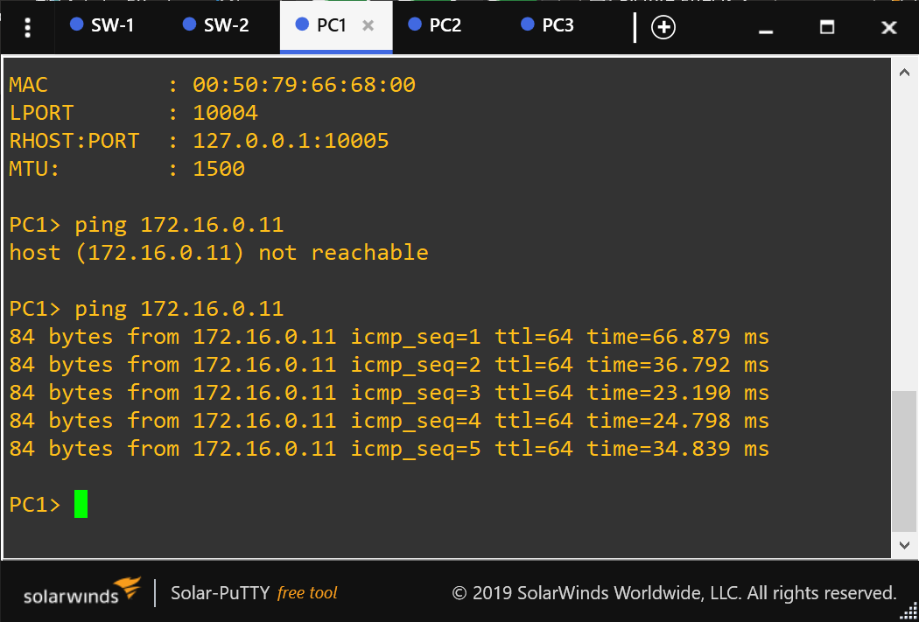
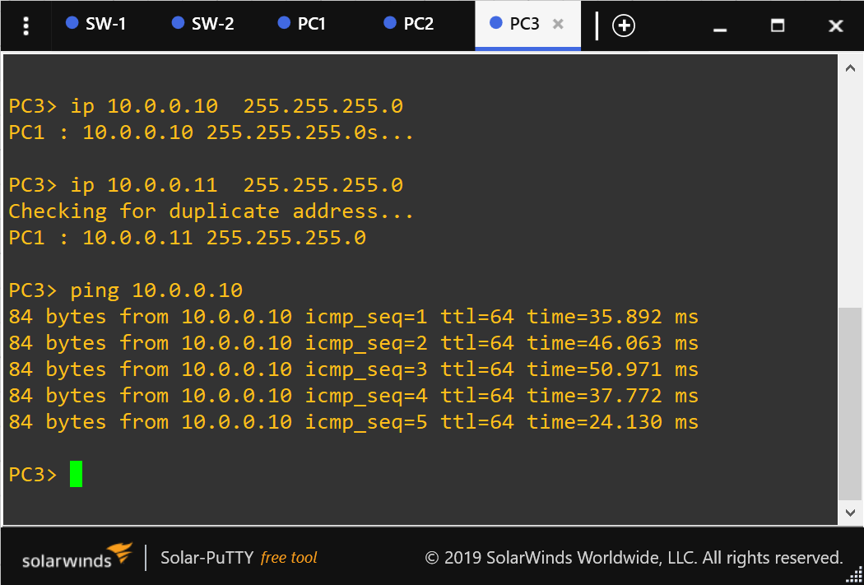

Testing Trunking Port g0/2

